Slide 1
Kairos Inside Workshop
Sarah Holwager, Institutional Liaison
Rockville Correctional Facility (Indiana)
Jonathan Kieffer, Advisory Council Chair
Jessup Correctional Institution (Maryland)
Shine!!

Slide 2
A.K.T.²
AFTER Kairos Training
What comes after the Weekend?
Leadership on the Outside
and on the Inside

Slide 3
Almighty, loving, gracious, merciful and forgiving Lord…
if I can’t be trusted to figure out what is best for myself and then do it, it becomes obvious that Your command is necessary. For if I know the law but still can’t keep it, and if the power of sin within me keeps sabotaging my best intentions, I obviously need help! I realize that I don’t have what it takes. I can will it, but I can’t do it. I decide to do good, but I don’t really do it; I decide not to do bad, but then I do it anyway. My decisions, such as they are, don’t result in actions. Something has gone wrong deep within me and gets the better of me every time. Lord, in Jesus’ name, I ask for something more! I want to be ALL IN. Amen.
Romans 7:15-20 The Message

Slide 4
Agenda
Rationale for the Workshop
Preparing the Team for the
Weekend: Of One Accord
Preparing the Residents for the
Weekday: Prayer and Share
Preparing the Inside Council for the
Weak Flesh: Reunion

Slide 5

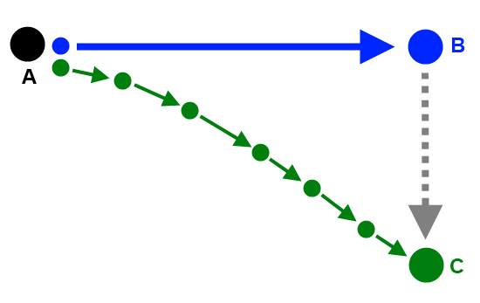
Course Correction
AKT
4th Day Ministry
Teaming
Forming
Team
Meeting
3 Day Weekend
Changing Hearts, Transforming Lives, Impacting the World
Notes:
Review with trainees: This is on page 76 of their manuals
Some of the many details involved with implementing the Kairos Inside program are less important than others….. Example – the menu for the Weekend. But other details are very significant and they are included in the Riverbanks. Each Weekend Leader has been given the authority by their Advisory Council, and the State Chapter Committee (they approve every Weekend Leader) to lead their Weekend, but they must stay within the Riverbanks of the Kairos Methods.
During the teaming process the River is wide – a Weekend Leader can make choices about how to prepare their team, but on the Weekend the Riverbanks are very narrow.
Weekend Leaders must understand the methods of the program and the impact on the program if they do not stay within the “Kairos Riverbanks”.
Think of planning a long trip. You know where you want to end up, and you plan a path to get you there.
As you begin the journey, you make a small error in your path - just a small one – no big deal.
But, over time, that small error takes you further and further away from your original, intended destination. With time, that small error ends up resulting in a big problem that is costly and time consuming to correct.
That is what happens when do not stay within the Riverbanks… at the time we may not see as a big deal. But over time things that are no big deal happen more and more frequently, or we bring in traditions from other programs or ministries, or we do things the “way they have always been done, and eventually the program is unrecognizable……..
We become disobedient – we are not following the program…. WE ARE OUT OF THE RIVER, ON TO THE SHORE, AND MOVING INLAND QUICKLY!
Other things that can be mentioned – reasons for drift :
Pride – wanting to make the Weekend their own
Ignorance - have not read the manual, and don’t know the program – not an excuse
(Program Manual Reference _______________________)

Slide 6
Ezra is:
What to do…
Ezra is not:
How to do…
In Hebrew the meaning of the name Ezra is:
Help, helper.

Slide 7
I can only imagine…
A training without ANY paper.
An Ezra experience where I don’t type in ANY team information.
A training with upbeat Christian music videos.
A “silver book” that is tattered, highlighted, and bookmarked with Post-It notes.

Slide 8
What is the PURPOSE of Team Formation Meetings?
(Teaming)

Slide 9
WE ARE THE CHURCH!

Slide 10
Team Formation
We are MANY churches… but one CHURCH.
Leaders need to focus on a Devotional Journey…
not on an “Ezra Checklist.”
Eight Themes… Eight “Meetings”
Vulnerability
Servanthood
God’s Love
Human Love
Humility
Gratitude
Compassion
Affirmation

Slide 11
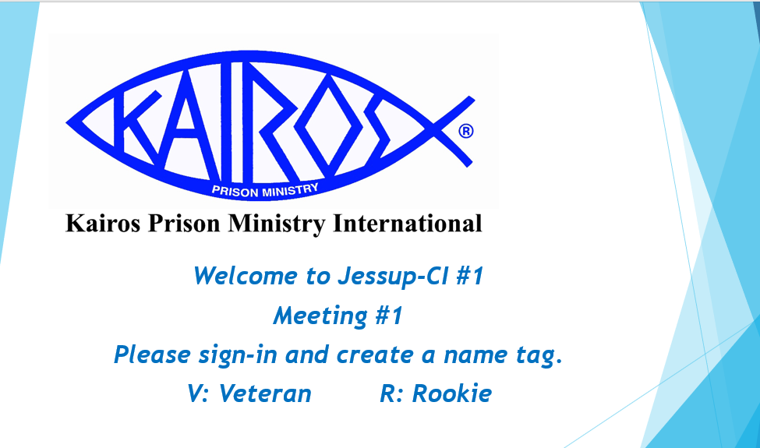
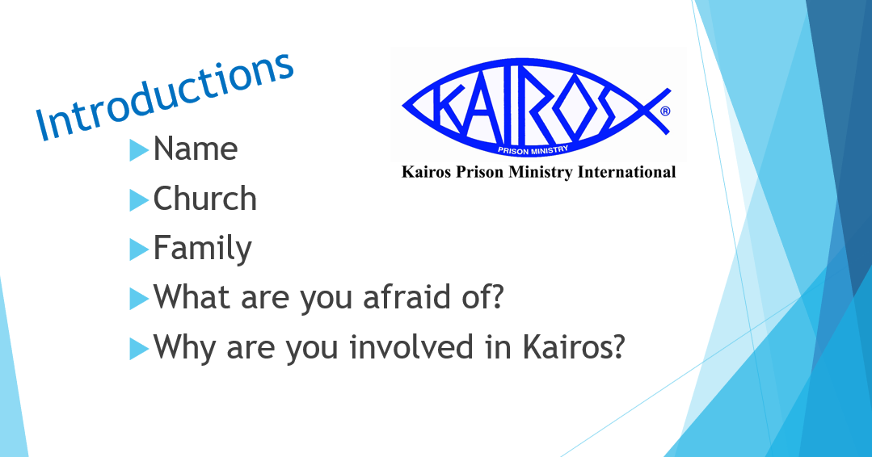
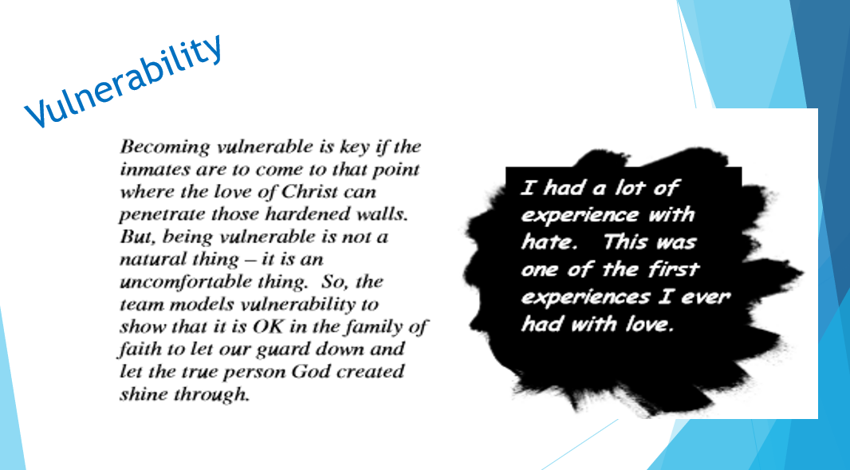
Watch This: Where is your Vulnerability?
Watch This: Humility

Slide 12
Group Dynamics
AKT Review
IN-clusion
Power and Control
Affection
Continuing Community
Tuckman Research
Forming
Storming
Norming
Performing

Slide 13
4th Day Ministry

Slide 14
Prayer and Share
Training Participants
Re-introduced/Re-Emphasized at EVERY Instructional Reunion.
Plan for 10 Minutes of Prayer and Share at EVERY Reunion.
Limit number of participants in a Prayer and Share Circle to 6.

Slide 15
Prayer and Share
Participant Guidelines
One hour per week (Check MOU with institution).
Participants must have attended a Kairos Weekend.
Three to six participants to a circle.

Slide 16
Prayer and Share
Volunteer Guidelines
Listen, listen. Love, love.
Establish volunteer Prayer and Share Circle.
Come together with participants at end to share joys and concerns, and to sing Surely the Presence.

Slide 17
Prayer and Share
Grouping Cards
Volunteers should use them in their circle.
Card is key to successful Prayer and Share Circle.
Questions reinforce Accountability and Discipleship.

Slide 18
Prayer and Share
Grouping Cards Questions
Share a moment when Christ’s presence was with you.
Have you discovered anything that helps you be a better follower of Jesus?
Has there been a time when you tried to help someone recognize God’s love for them?
Has there been a time when it was difficult to show Christ’s love to another person?
Are there things you are thankful for that we can pray about together?

Slide 19
Inside Resident
Community Council
Eligibility
Must have attended a Kairos Weekend.
Attend Prayer and Share and Reunions on a regular basis.

Slide 20
Inside Resident
Community Council
Major Roles of IC
Encourage all Kairos graduates to group regularly.
Where Prayer and Share not allowed, actively encourage Kairos graduates in Christian Fellowship within the institution.

Slide 21
Inside Resident
Community Council
Major Roles of IC
Plan the Monthly Reunion
Inside Council should seek assistance by Chaplain or Institutional Liaison
Encourage participants to continue to invite loved ones to Kairos Outside.

Slide 22
Inside Resident
Community Council
IC Planning for Reunions
Pick a topic
Scripture
Devotions
Music
4th Day Speakers
Volunteers as guests

Slide 23
Questions?
Thank you for joining us!
Please complete the session evaluation when you have a chance.

